Slide 1
Final ChatApp
By Team Freedom
Team Lead: Mengjie Zhao
Tech Lead: Yang Pan
Doc Lead: Hao Ding
Developer: Jialei Zhou, Yanshu Wei, Haoran Liang

Slide 2
Agenda
Design Decisions Mengjie Zhao
Frontend Design Yanshu Wei
Backend Design Hao Ding
Example Walk Through Jialei Zhou
Demo Haoran Liang

Slide 3
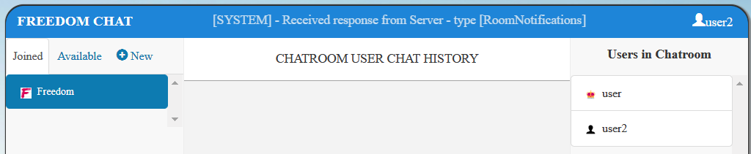
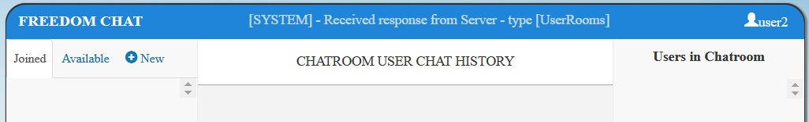
Design Decisions
If a owner leaves the room (exit, exit all, send “hate”, disconnected)
The room will be dismissed and no longer available to all users
Owner User choose to leave room “Freedom”
The room “Freedom” will disappear in both Joined & Available

Slide 4
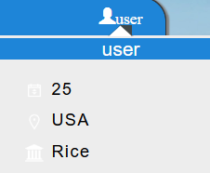
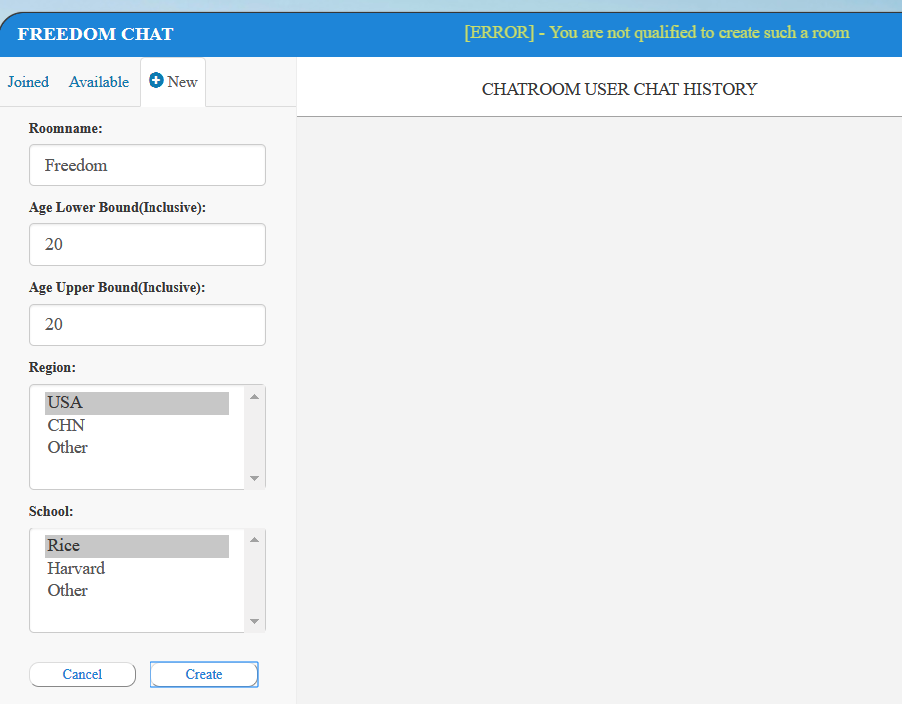
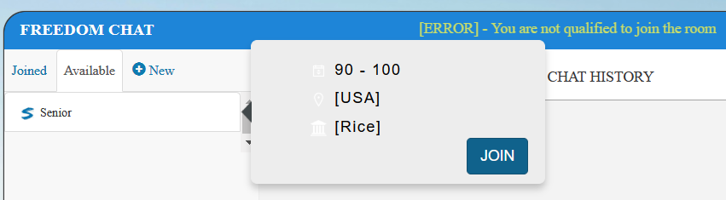
Design Decisions
A user can only create/join rooms they are qualified
Not qualified to create
Not qualified to join

Slide 5
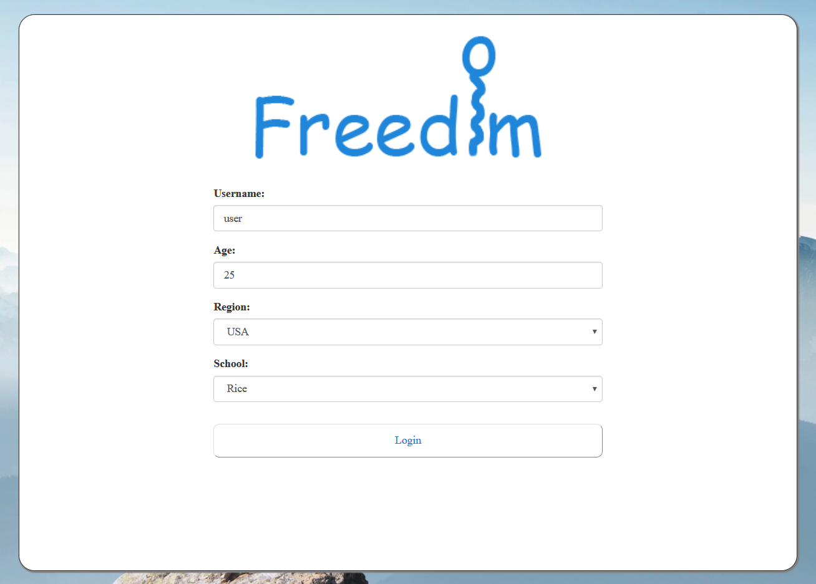
Frontend Design - Login

Slide 6
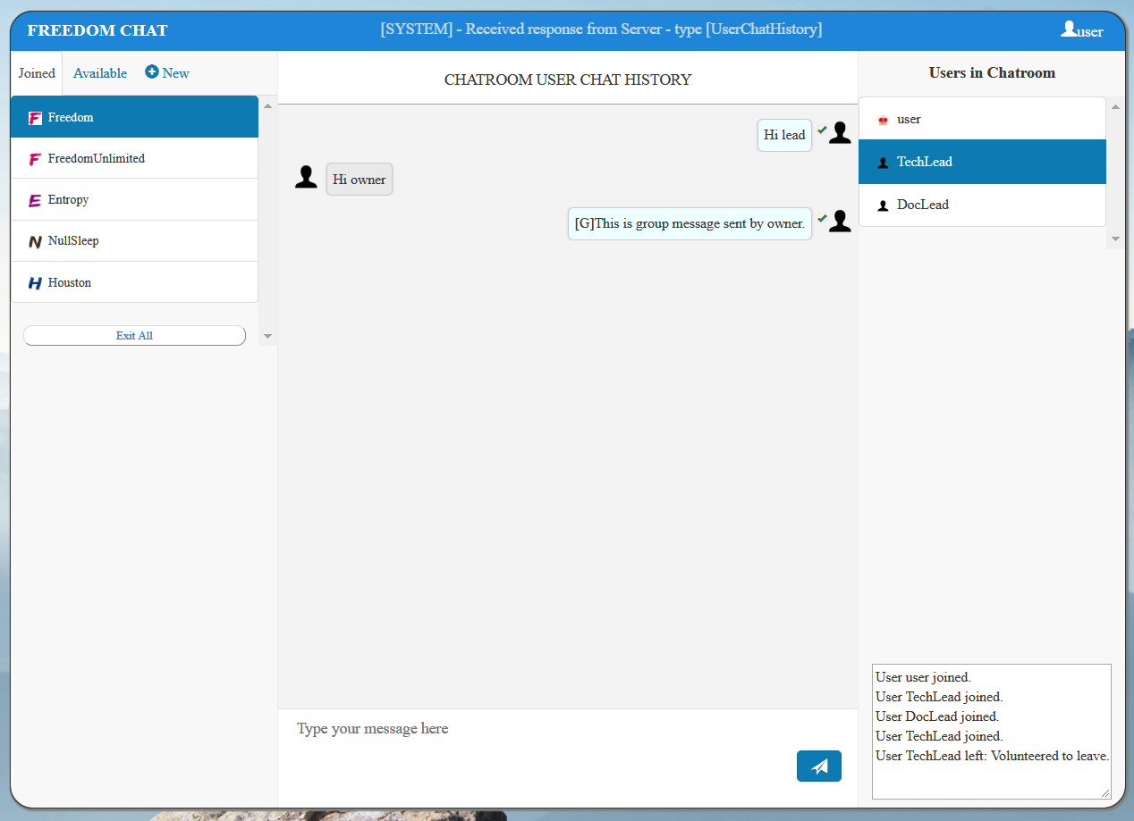
Frontend Design – Chatroom Overview
App System Info
Room Info
Joined
Exit All
Available
Create New
Chat History
User List
All user join leave history

Slide 7
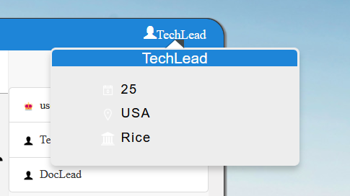
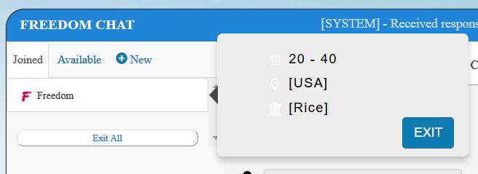
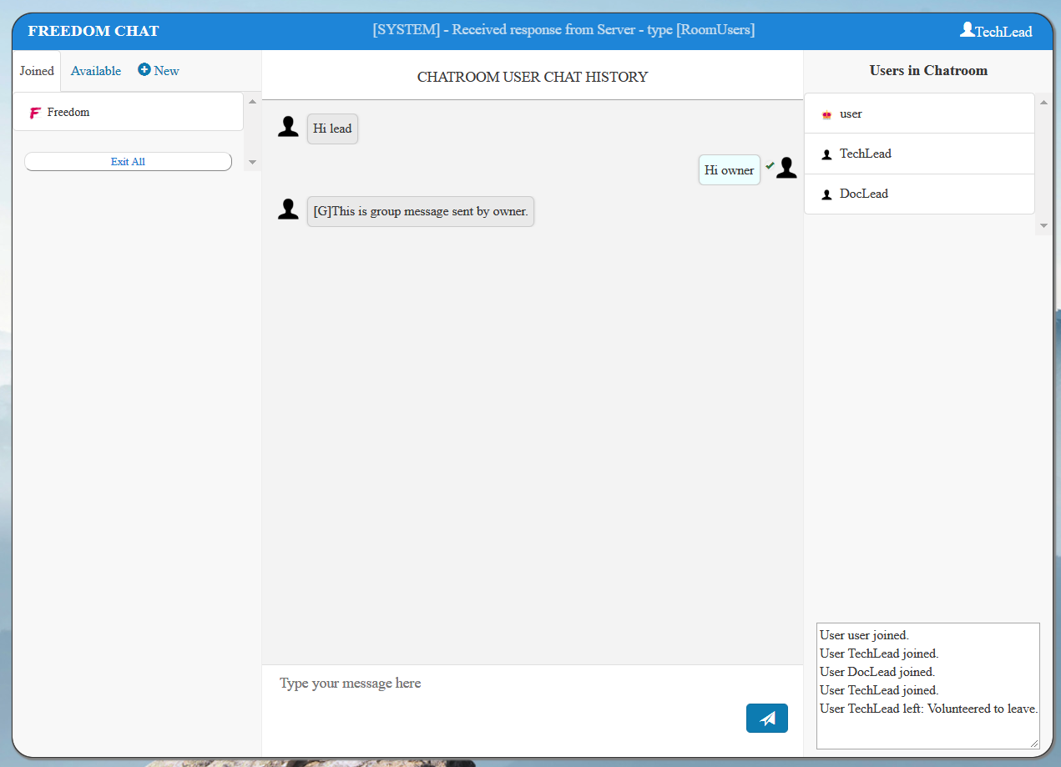
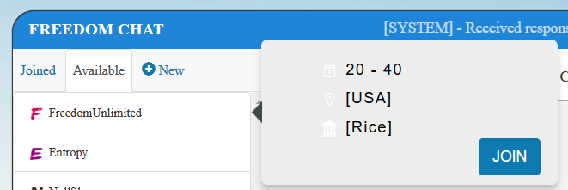
Frontend Design – Chatroom Mouse Hover and Pop up
Hover on user name
Hover on joined room
Hover on available room

Slide 8
Frontend Design – Chatroom Chat
1- click to show room user list
2 – click to show chat history
√ - received
Chat History
3 – click to send message

Slide 9
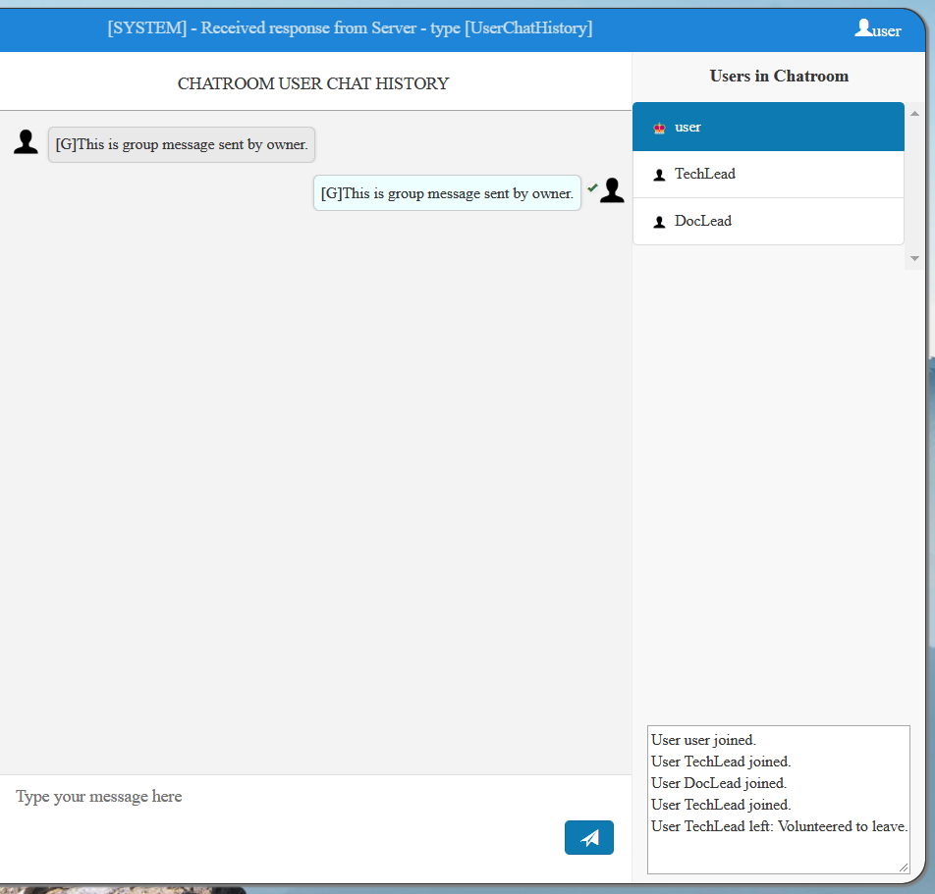
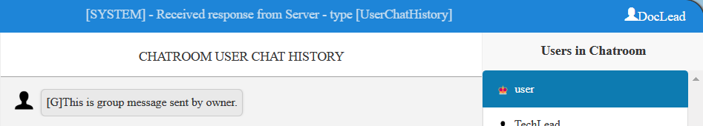
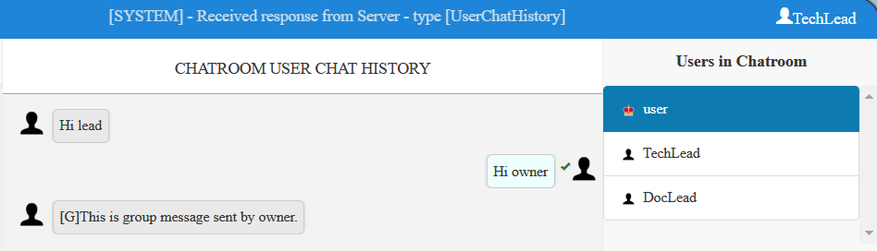
Frontend Design – Chatroom Owner Send to All
1 – owner click on itself
[G] – group message
2 – click to send to all

Slide 10
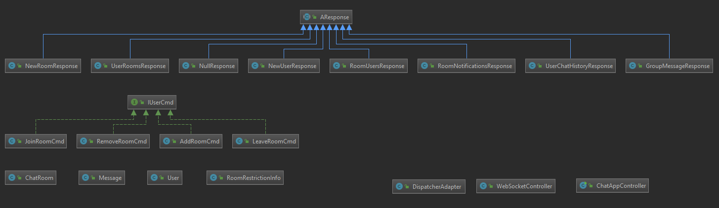
Backend - API and UML
Add Abstract Class AResponse to facilitate Model to View communication. It will store all the information to be passed back from model to view

Slide 11
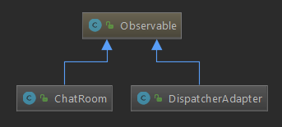
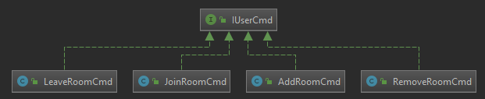
Backend - Design Pattern
Observable
Observer
User
Observable
Dispatcher - Dispatcher will notify all existing users
ChatRoom - ChatRoom will notify all users in the room
Command
Used in conjunction with Observable/Observer Design pattern to notify corresponding users

Slide 12
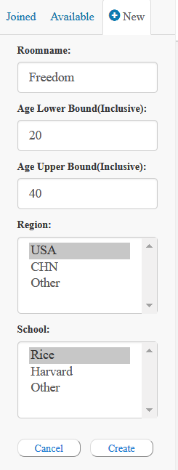
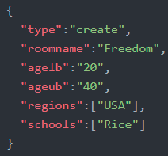
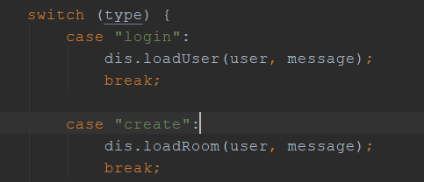
Example Create Room – Frontend to Backend
chatapp.js
webSocket.send()
WebSocketController
onMessage()

Slide 13
Example – Create Room – Backend Processing
Joined Room
Freedom
Available Room
Dispatcher all users
Owner
User1
User2
Dispatcher all rooms
Freedom
Owner
Joined Room
Available Room
Freedom
loadRoom
DispatcherAdapter
User1
1. Create and store new room in dispatcher
3. Add the new room to all observers(users)
and notifyClient(user, response)
Room
Freedom
Joined Room
Available Room
Freedom
AddRoom Cmd
User2
Room Freedom
2. Wrap the room in AddRoom Cmd

Slide 14
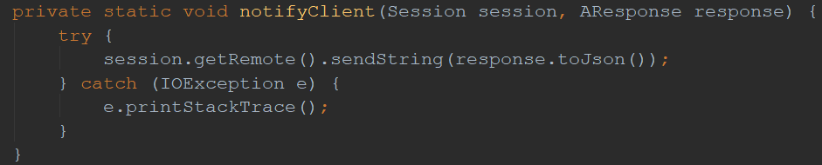
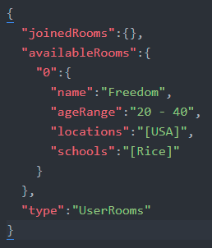
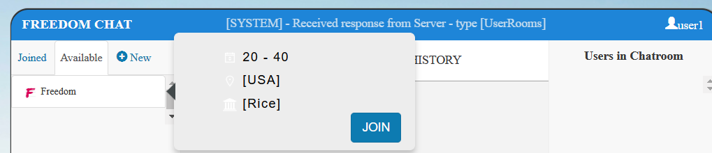
Example Create Room - Backend to Frontend
chatapp.js
userRoomsHandler()
DispatcherAdapter
NotifyClient()

Slide 15
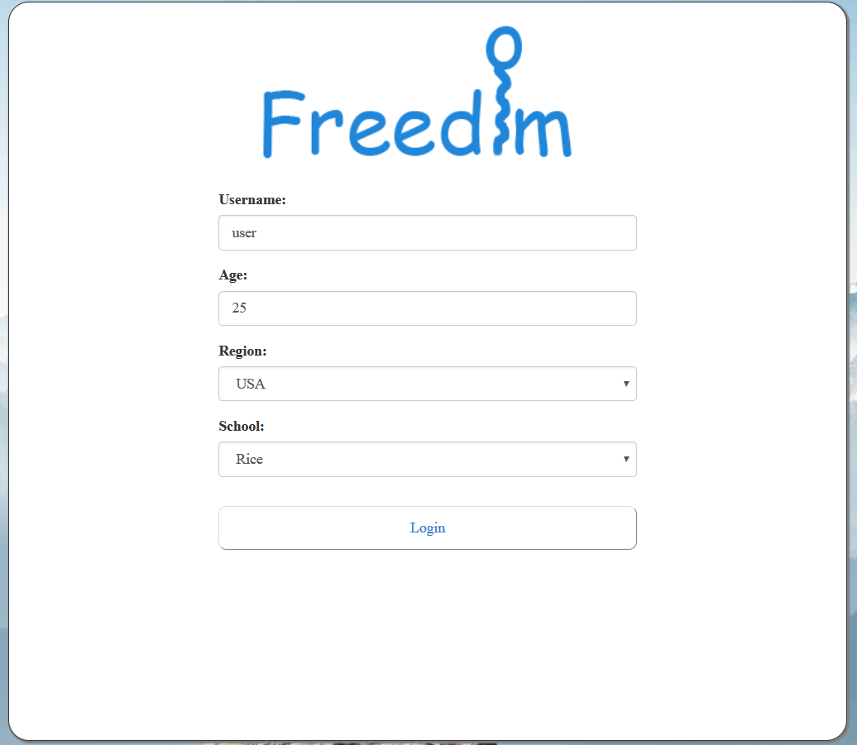
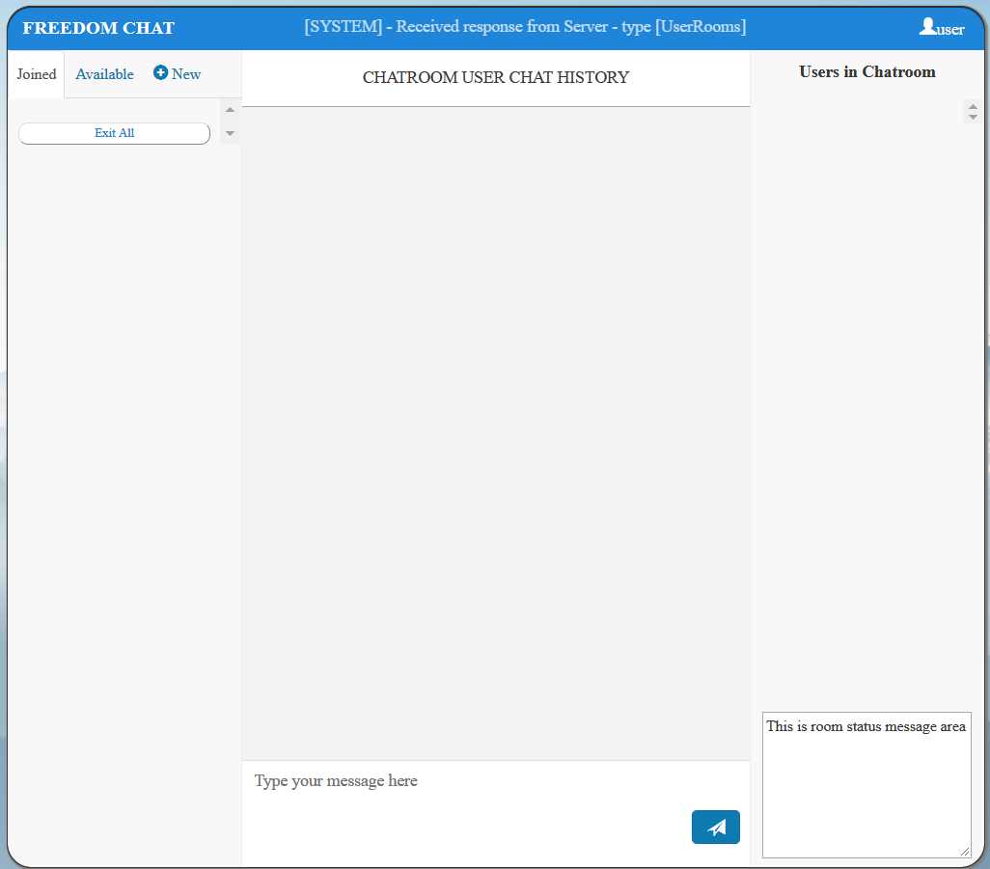
Demo
https://chatapp-team-freedom.herokuapp.com/

Slide 16
Q&A

